Slide 1
shallow and deep copying

Slide 2
Cloning is a process of creating an exact copy of an existing object in the memory.
In java, clone() method of java.lang.Object class is used for cloning process.
This method creates an exact copy of an object on which it is called through field-by-field assignment and returns the reference of that object.
Not all the objects in java are eligible for cloning process.
The objects which implement Cloneable interface are only eligible for cloning process. Cloneable interface is a marker interface which is used to provide the marker to cloning process.

Slide 3
Shallow Copying
Definition:
Shallow cloning
Shallow copying is a bit-wise copy of an object.
A new object is created that has an exact copy of the values in the original object.
If any of the fields of the object are references to other objects, just the reference addresses are copied i.e., only the memory address is copied.
In shallow cloning by using cloned object reference if we perform any change to the contained object then those changes will be reflected to the main object. To overcome this problem we should go for deep cloning.

Slide 4
Deep copying
Definition: Programmer is responsible for deep cloning.
The process of creating exactly duplicate independent copy including contained object(reference) is called deep cloning.

Slide 5
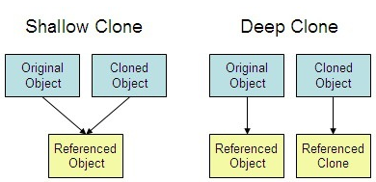
Diagramatic example

Slide 6
protected native Object clone() throws CloneNotSupportedException
Both shallow copy and deep copy are related to this cloning process.
The default version of clone() method creates the shallow copy of an object.
To create the deep copy of an object, you have to override the clone() method.
Let’s see how these shallow copy and deep copy work.

Slide 7
https://www.youtube.com/watch?v=L-p-RGTNrZg

